Slide 1
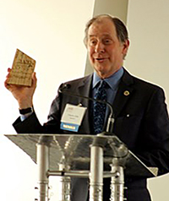
MnDOT Public Engagement Awards
Public Engagement and Constituent Services (PECS) Office
March 13, 2018

Slide 2
Background
Recognizes agency efforts to engage Minnesotans in decision making to improve transportation projects, programs and services
WIG 2.0: Improve Intentional Customer Engagement
Diversity and Inclusion Unified Strategic Work Plan
  MnDOT will demonstrate and share best public engagement practices
Compliments awards programs sponsored by MnDOT’s Planning and Environmental Stewardship Offices, as well as the awards program of the International Association of Public Participation (IAP2)

Slide 3
Award Program Plan
Call for nominees will begin later this year
Award selection committee (to be solicited) will be comprised of district leaders and public engagement practitioners from across the state
Inaugural Public Engagement award winners will be announced at the Public Engagement workshop next spring

Slide 4
MnDOT Public Engagement Award Categories
Creativity and Innovation
Respect for Diversity, Inclusion, and Culture
Best Engagement for a Small/Medium Project
Best Engagement for a Major Project
Ongoing Engagement by Office/District

Slide 5
Questions? Comments?
Contact Kjensmo Walker
Kjensmo.Walker@state.mn.us
651-366-3177

